Slide 1

Patterns in Worldwide Suicide Rates
TEAM 1
Richard Guarnieri
Erick Macias
Enrique Ayala
Javier Burnes

Slide 2
The Outline
Death by suicide is an extremely complex issue that causes pain to hundreds of thousands of people each year around the world. Our project is to uncover patterns in worldwide suicide rates. We will examine the relationships between number of suicides across multiple countries, years, genders, ages and several demographic and socioeconomic factors in order to understand if there are underlying factors influencing suicide rates across the world.

Slide 3
Questions
How do socioeconomic variables affect the suicide rate by country?
In which countries are there more suicides and how is the standard of living in them?
In what age range are there more suicides?
What gender is more likely to commit suicide?

Slide 4
Data
We seek for the datasets in the Kaggle website, and we decided to use two different datasets combined.
Datasets:
Demographic and Socio-economic (UNESCO)
Demographic: fertility rate, life expectancy, motality rate, population growth, etc…
Socio-economic: GDP growth, GDP per capita, government total expenditure, etc…
Source: https://www.kaggle.com/krukmat/demographic-and-socioeconomic-unesco
Suicide Rates Overwiew 1985 to 2016
Variables: year, country, number of suicides by year, population by year, etc…
“This compiled dataset pulled from four other datasets linked by time and place. It was built to find signals correlated to increased suicide rates among different cohorts globally, across the socio-economic spectrum”.
Source: https://www.kaggle.com/russellyates88/suicide-rates-overview-1985-to-2016

Slide 5

Data Exploration Cleanup Process

Slide 6
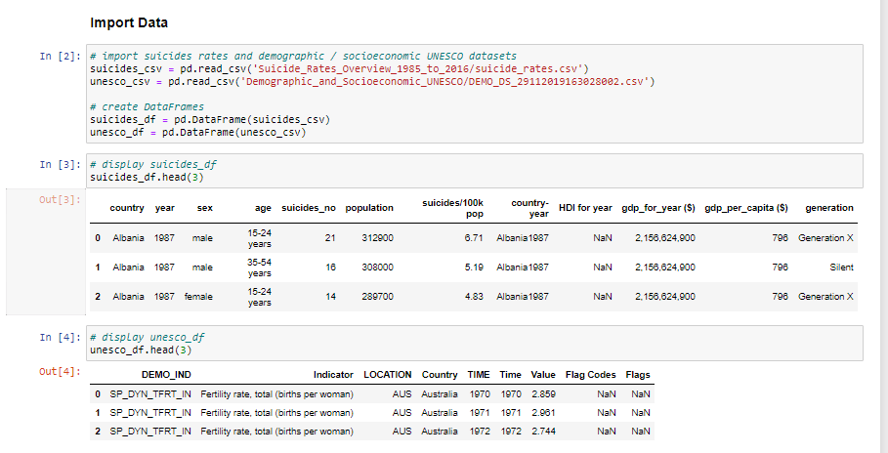
We started by importing the two Dataframes we got.

Slide 7
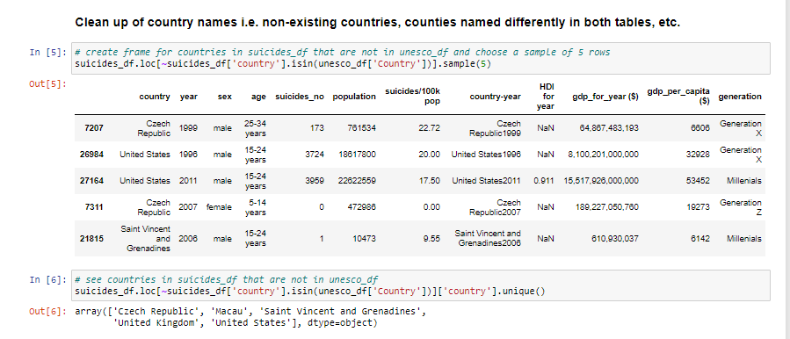
We noticed that there were countries in our suicide table that were not in the UNESCO data.

Slide 8
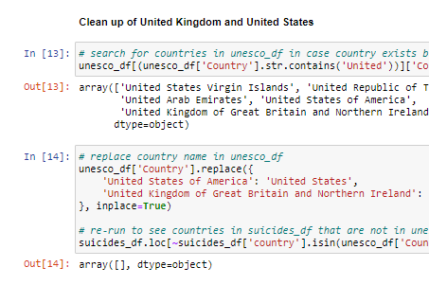
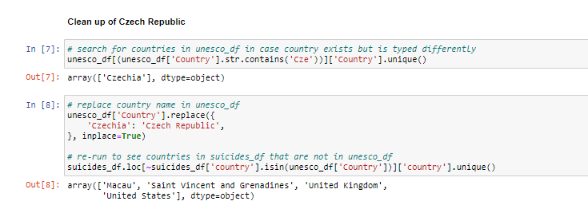
We look into the UNESCO table, to verify if the country does not exist in the table, or is with a different name, in this case the countries had a different name on each table, so we change the name on the UNESCO table to match with the name we have in the suicide table, so we can merge without trouble.

Slide 9
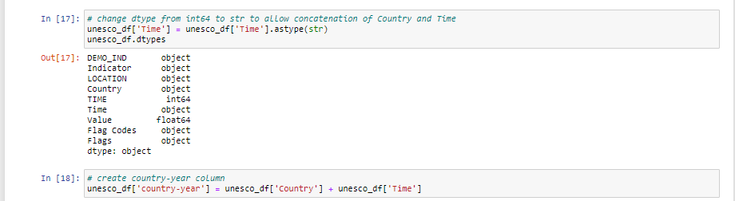
To merge the two tables, we create in UNESCO a new column call country-year. To do that, we had to convert the column ‘Time’ (where we have the year) into a string.

Slide 10
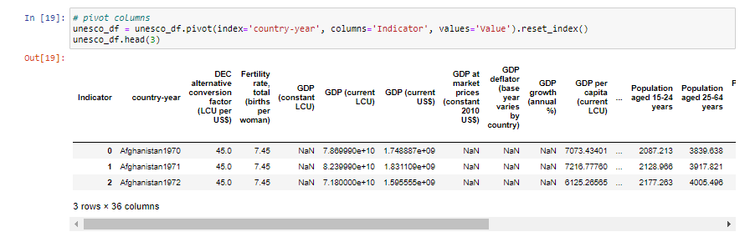
The UNESCO table had a format where all of the indicator where in a column, in order to transform them into columns we pivot the table.

Slide 11
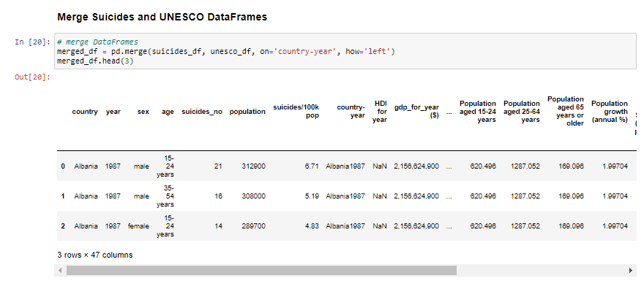
With all changes made we proceed to merge both tables. In this case we merged on our suicide table, since the information that is not there would not help us drive any analysis.

Slide 12
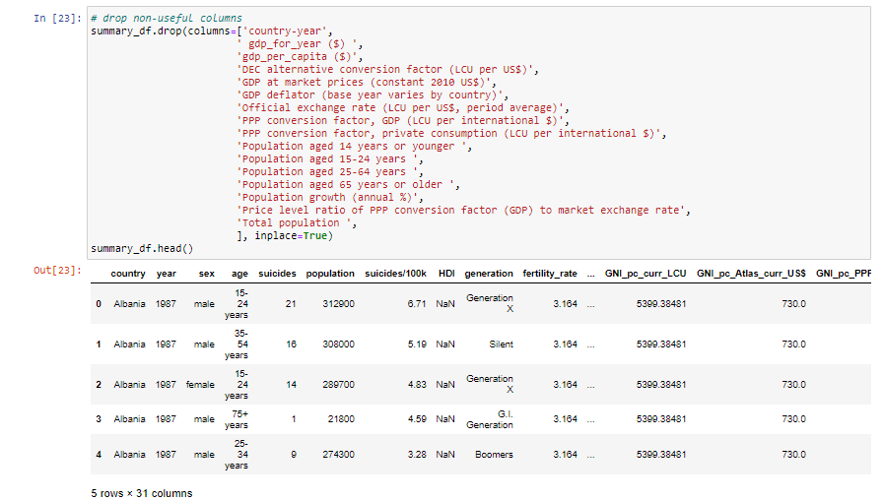
Now we proceed to drop the columns we are not going to use, and we are ready to start with our analysis!

Slide 13

Analysis Process

Slide 14

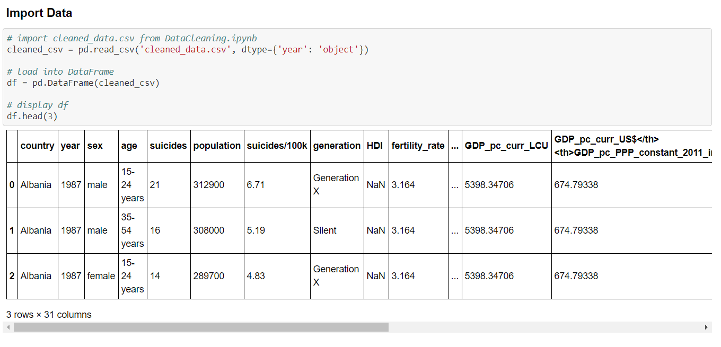

Slide 15
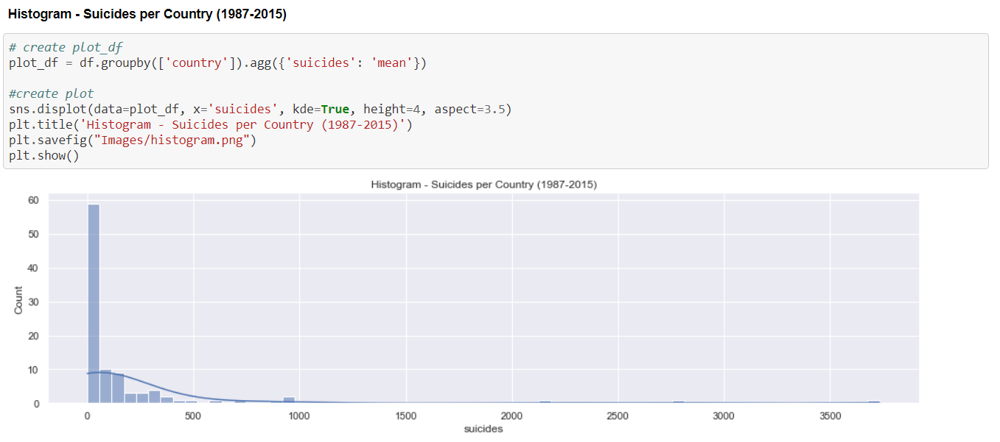

Slide 16
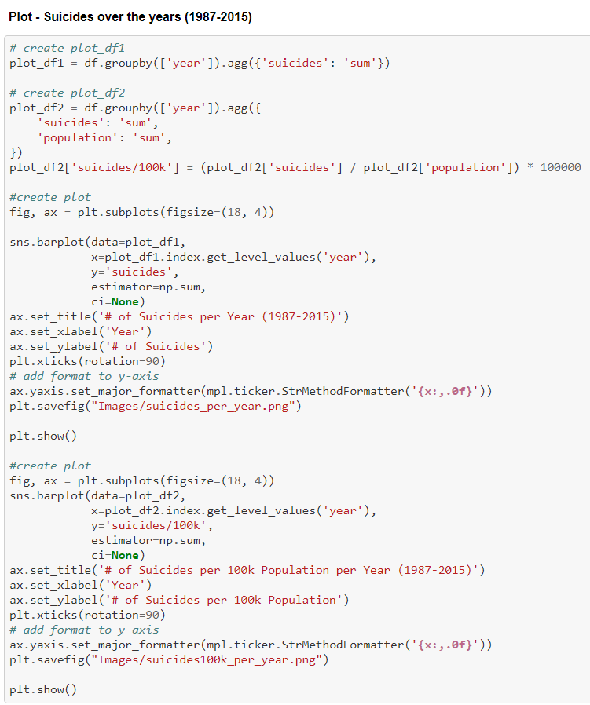
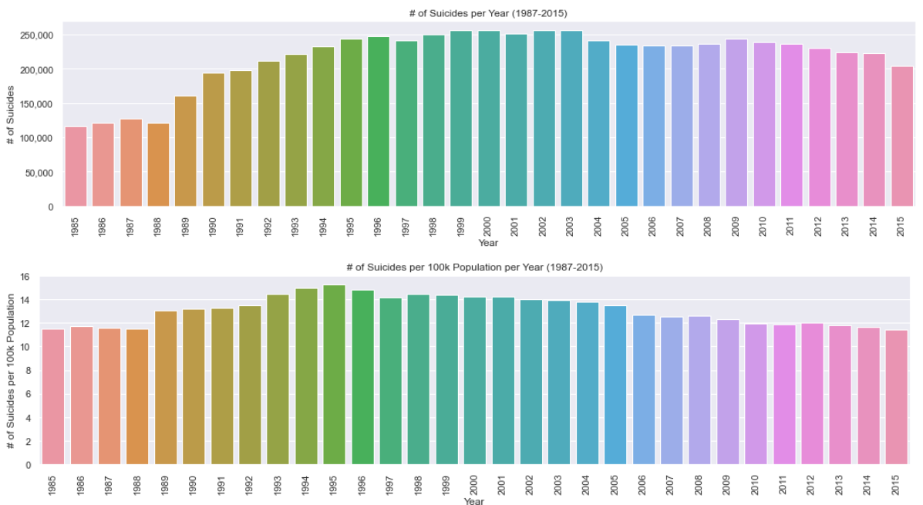

Slide 17
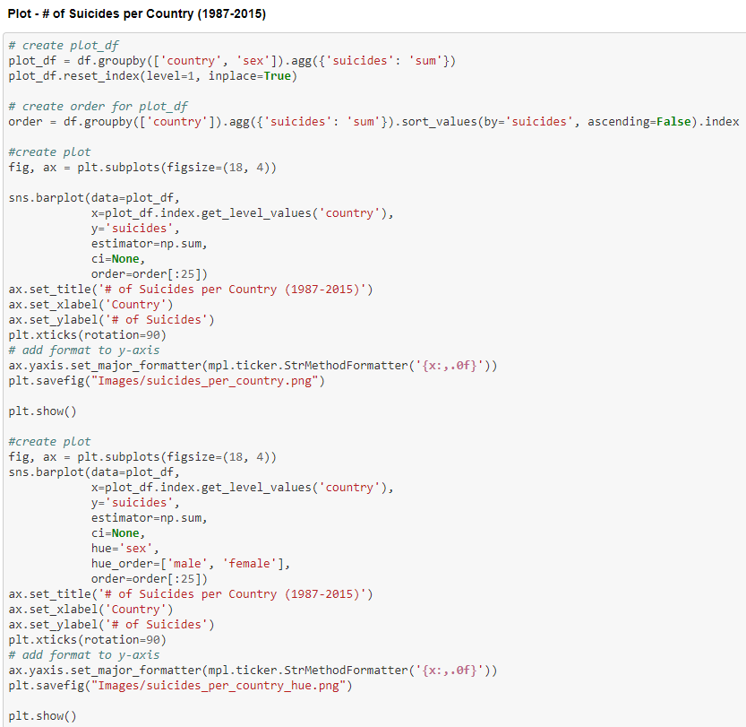
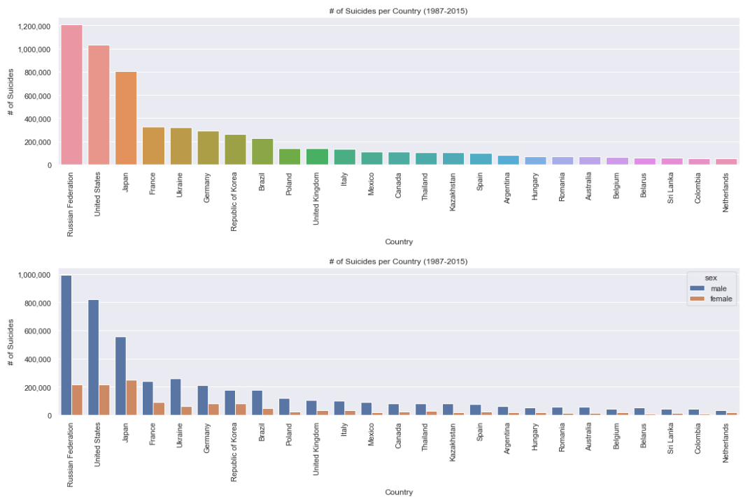

Slide 18
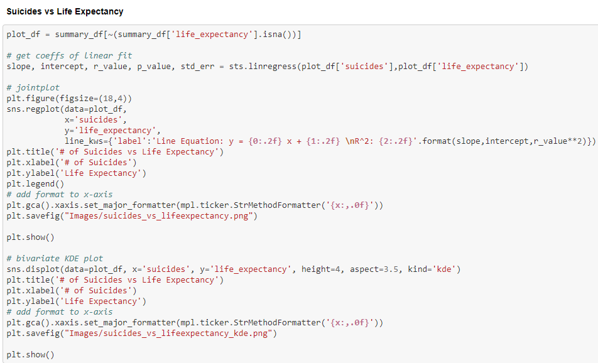
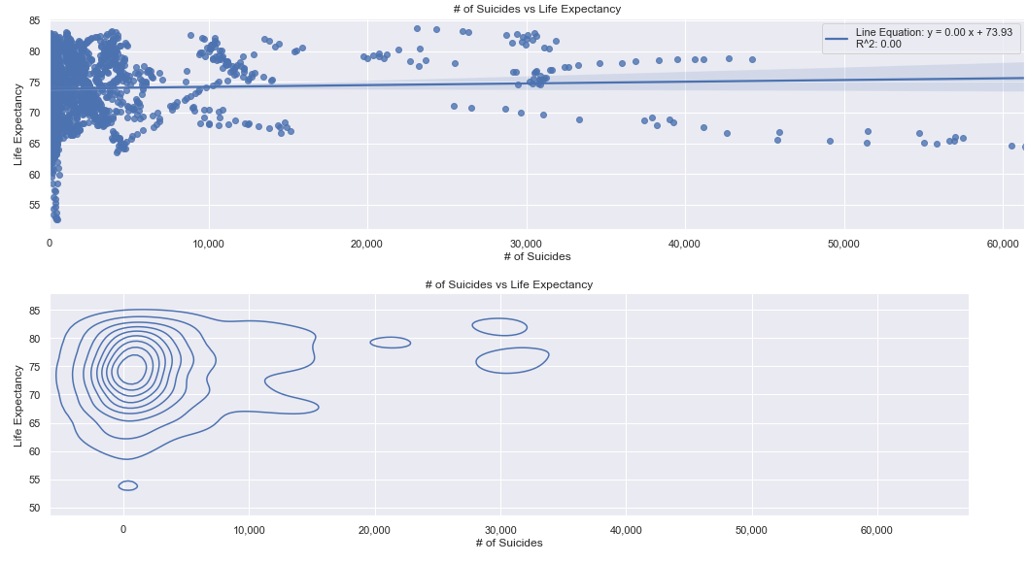

Slide 19
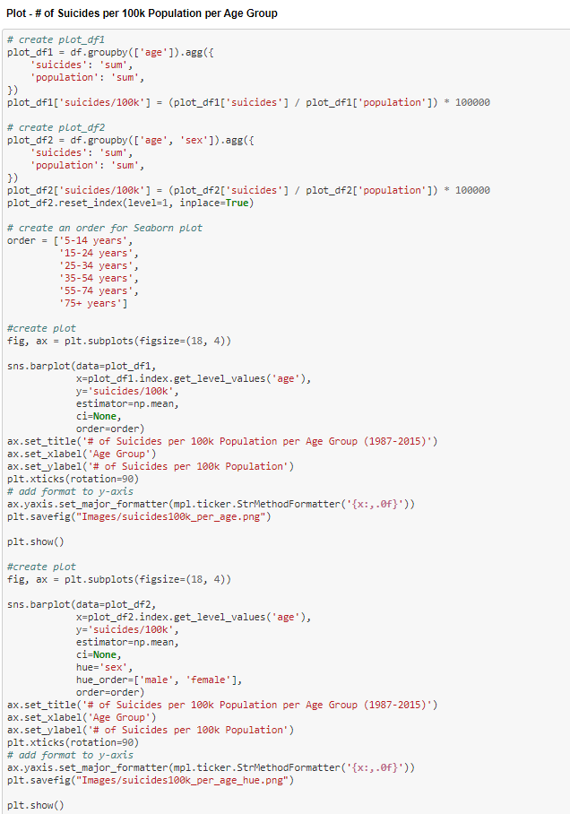
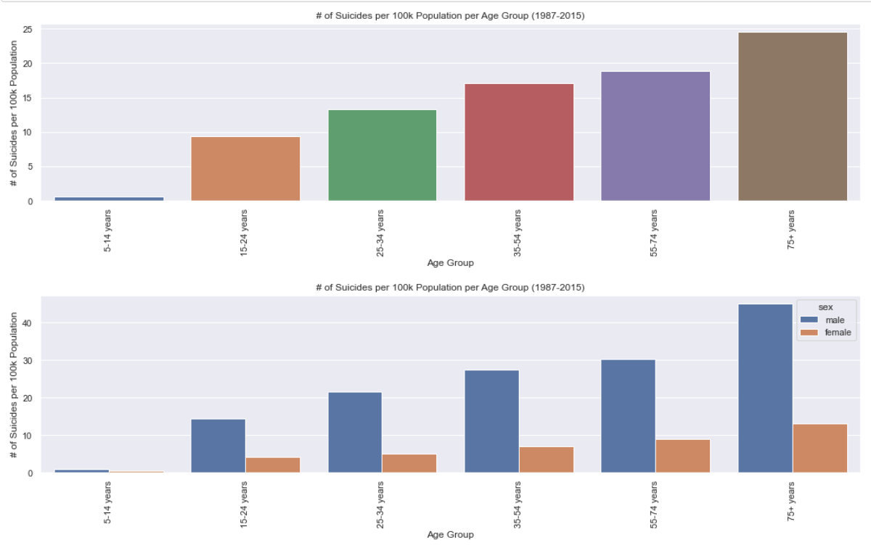

Slide 20

Multiple Lineal Regression

Slide 21
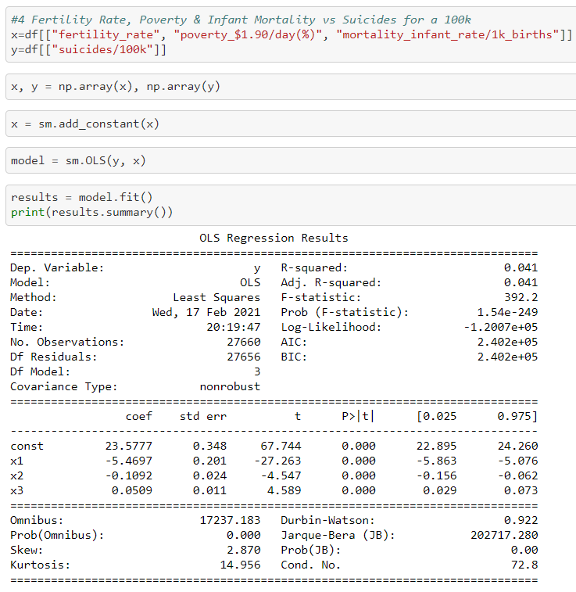
P value < α
0 < 0.5
Coefficients other than 0
y = 23.5777
x1 = -5.4697
x2 = -0.1092
x3 = 0.0509
Prob(F Statististic) : Close to 0, this would mean the regression is meaninfull.
R^2 has a correlation value of 4.1% the linear regression model cannot be explained with these 3 variables.

Slide 22
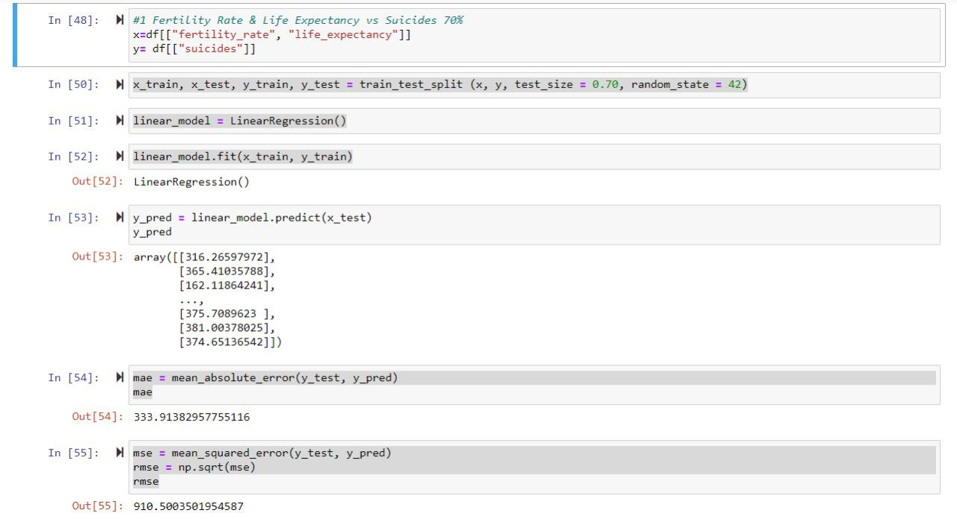
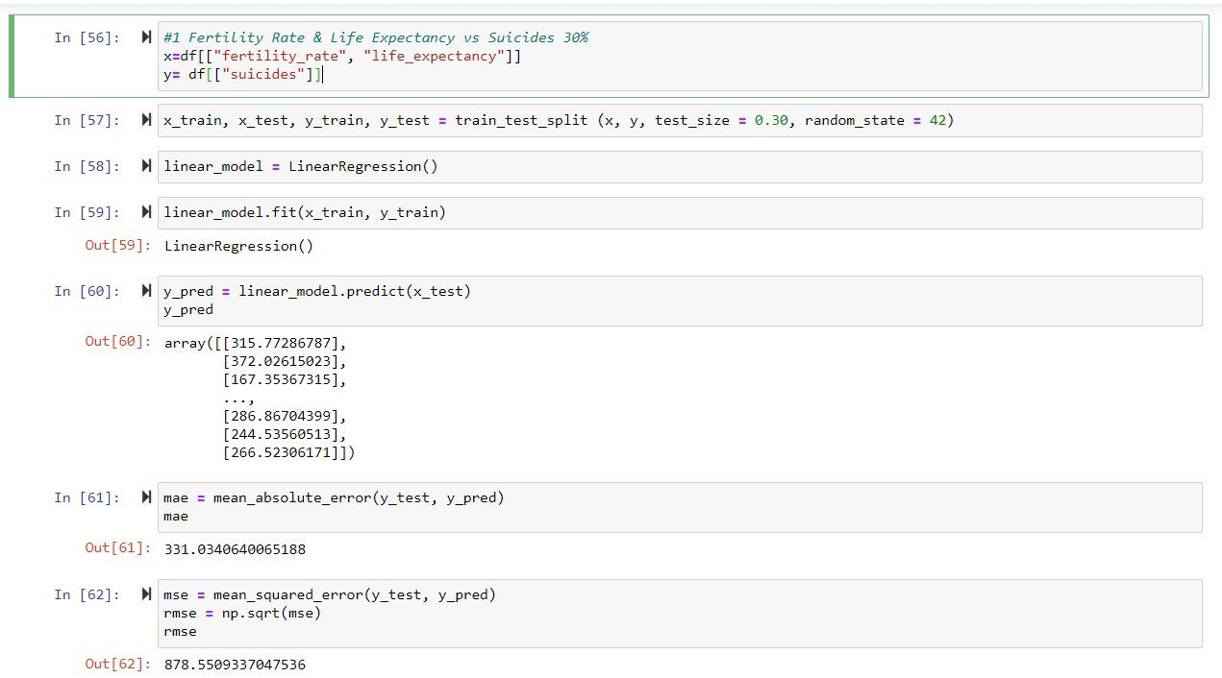
Our RMSE results are rather large, which in this case would indicate that our model does not fit the data. Test size of 0.70.
Our RMSE reduces with a population of 30% but still the model doesn’t fit the data.

Slide 23
Conclusions
Men commit a lot more suicide than women, not only in general, divided by country, and age group, men can commit up to 5 times more suicide than women.
With the age group we analyzed 5-14, 15-24, 25-34, 35-54, 55-74, 75+, there is a tendency where the older you are, the most likely you are to commit suicide.
From all the demographic indicators we analyzed, we weren't able to find any correlation with suicide/100k population.
The suicides/100k population started growing significantly in 1989, and peaked at 1995, from there we have had a reduction in the suicides/100k population.
Our regression models did not offer significant insight on any possible correlation.

Slide 24

Every suicide is a tragedy. The World Health Organization (WHO) and the Global Burden of Disease study estimate that almost 300,000 people die from suicide every year. That’s one person every 55 seconds.

